Slide 1
Auto-auth submission portal
Step-by-Step Process

Slide 2
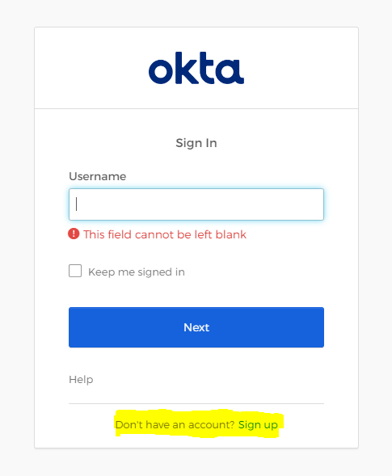
Creating An Account to Utilize the Portal
You can access the website by going to: priorauth.icppatient.com
You will be prompted to create an account
Once the account is created you will be able to login to the episode management portal

Slide 3
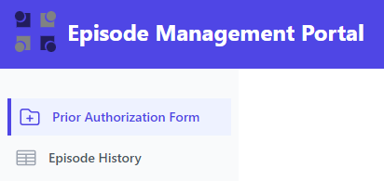
Episode Management Portal
The episode management portal has 2 tabs that can be utilized, Prior Authorization Form and Episode History:
Under the Prior Authorization Form you can submit new authorization requests
Under the Episode History you can view previously submitted authorizations, check status, and download the approval letter

Slide 4
Steps to submit new authorizations
Step-by-Step Process

Slide 5
Step 1: Prior Authorization Form
The Prior Authorization Form Tab will have 5 sections:
The Patient Information will require you to submit the (Health Plan) ID Number. For HonorHealth members this ID Number ends in SLHN. You will also be required to submit the Date of Birth.

Slide 6
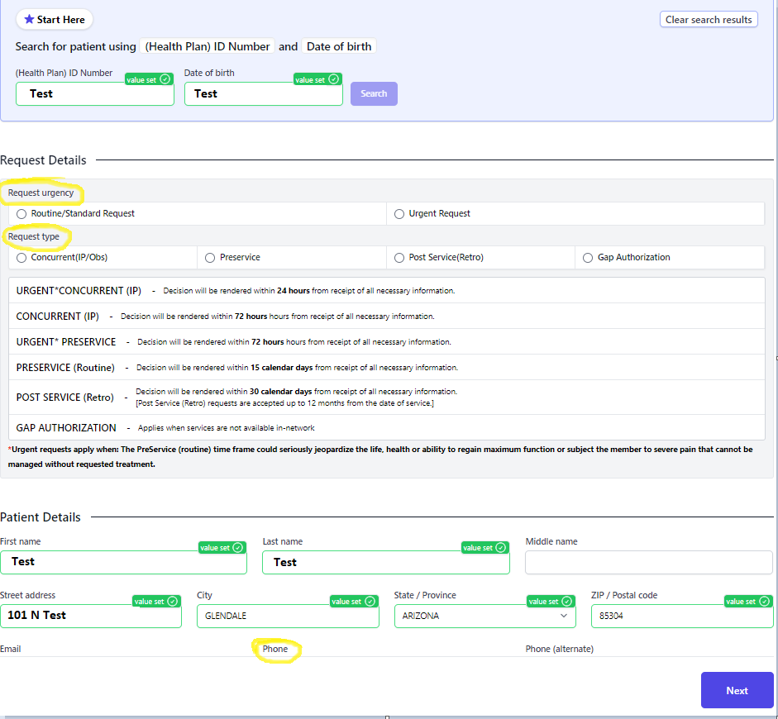
Prior Authorization Form
Once the (Health Plan) ID Number and Date of Birth are submitted your screen will look like this
-The green fields are pre-populated and cannot be edited
-The required fields are (circled to the right):
Request urgency
Request type
Phone

Slide 7
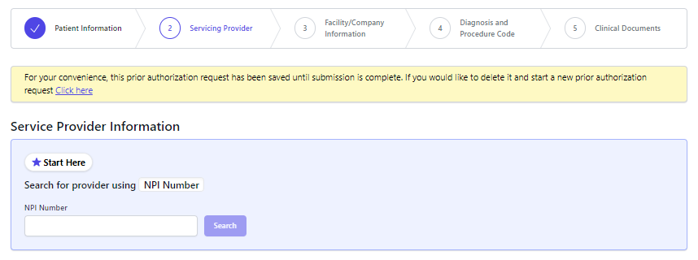
Step 2: Servicing Provider
The servicing provider tab will require for you to search for a provider using NPI Number

Slide 8
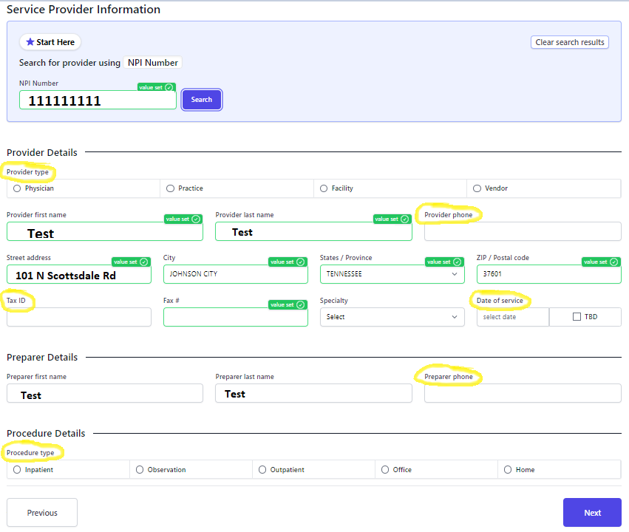
Servicing Provider
-The green fields are pre-populated and cannot be edited
-The required fields are (circled to the right):
Provider type
Provider phone
Tax ID
Date of service
Preparer phone
Procedure type

Slide 9
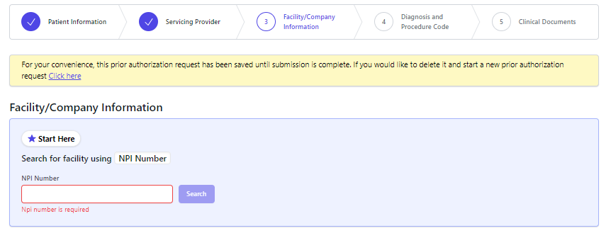
Step 3: Facility/Company Information
The facility/company information will require for you to search for a facility/company using NPI Number

Slide 10
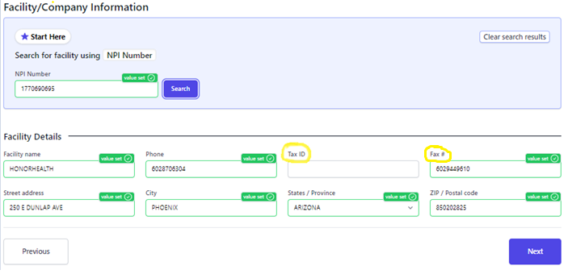
Facility/Company Information
The green fields are pre-populated and cannot be edited
The required field is Tax ID and Fax Number (circled below):

Slide 11
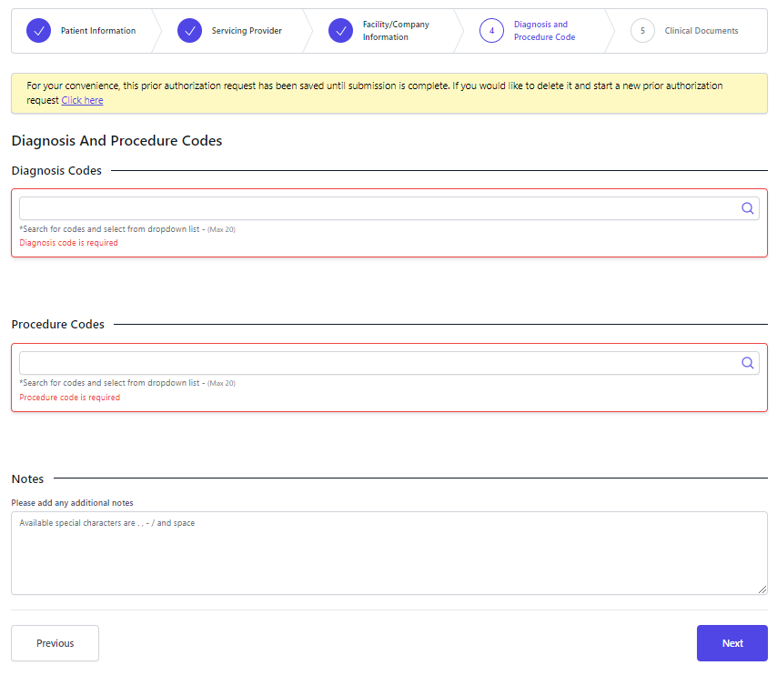
Step 4: Diagnosis and Procedure Code
Diagnosis Codes & Procedures Codes are required fields (outlined in red)
Once both have been inputted the number of units being requested will be required

Slide 12
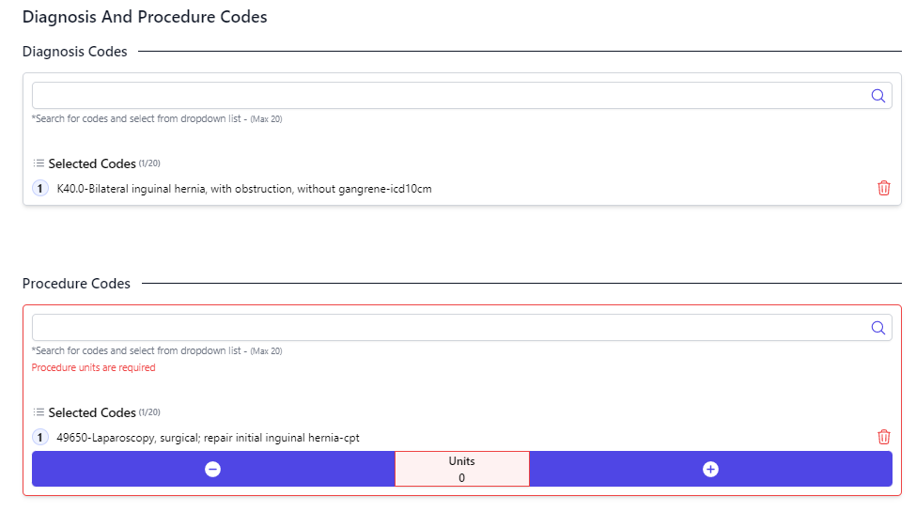
Diagnosis and Procedure Code
The number of units being requested will be required (outlined in red):

Slide 13
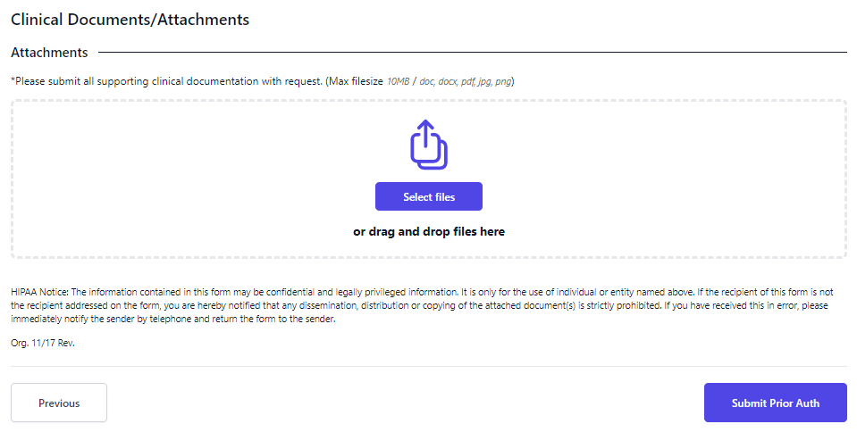
Step 5: Clinical Documents
Uploading any relevant clinical information that pertain to the service(s) being requested is a requirement.
Acceptable documents:
Office notes
Progress notes
History and Physical (H&P)
Diagnostic Test Results
Treatment Plan
Information on consultations with treating practitioners
Hospital Records
Discharge Summary
Other relevant clinical information that supports the need of your request

Slide 14
Documenting Guideline
Step-by-Step

Slide 15
Step 1: Request Form
Service From Date and Service To Date is required
Please note the date range should be in 3-month increments

Slide 16
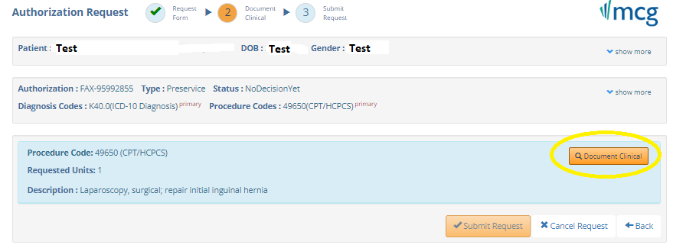
Step 2: Document Clinical
Document Clinical will be required before you can submit the request (circled below):

Slide 17
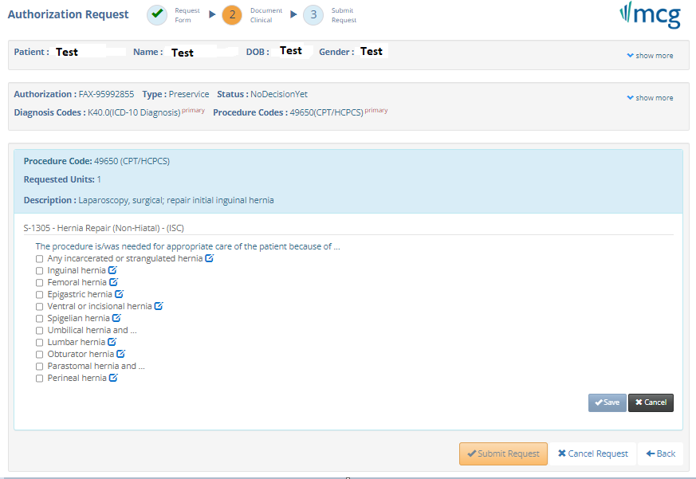
Document Clinical & Submit Request
Once Document Clinical is clicked the guideline for the procedure being requested will appear
Documentation of the reason member needs this procedure is required
Once you document you can save and submit request

Slide 18
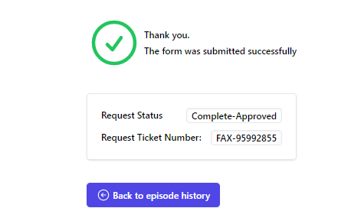
Determination
If indications are met on the guideline a “Complete-Approved” will be available immediately
If indications are not met the request status will be “Pending”
A “Request Ticket Number” will be provided for every submission

Slide 19
Back to Episode History
Once Back to Episode History is clicked, prior-authorizations that have been submitted can be tracked
If the “Request Status” was “Complete-Approved”, documents of approval can be obtained by clicking the Download Icon
If the “Request Status” is “Pending”, the prior authorization team will review the request and return a determination within ICP’s turnaround times.
After a determination is returned, the Status and Documents will be available within 24 hours.
To check the Status of an authorization, login back into the portal and go to the Episode History Tab.

